Slide 1
Team 2
Jonathan Kernaghan David Bradley Matthew Elliott

Slide 2
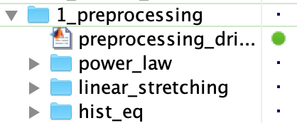
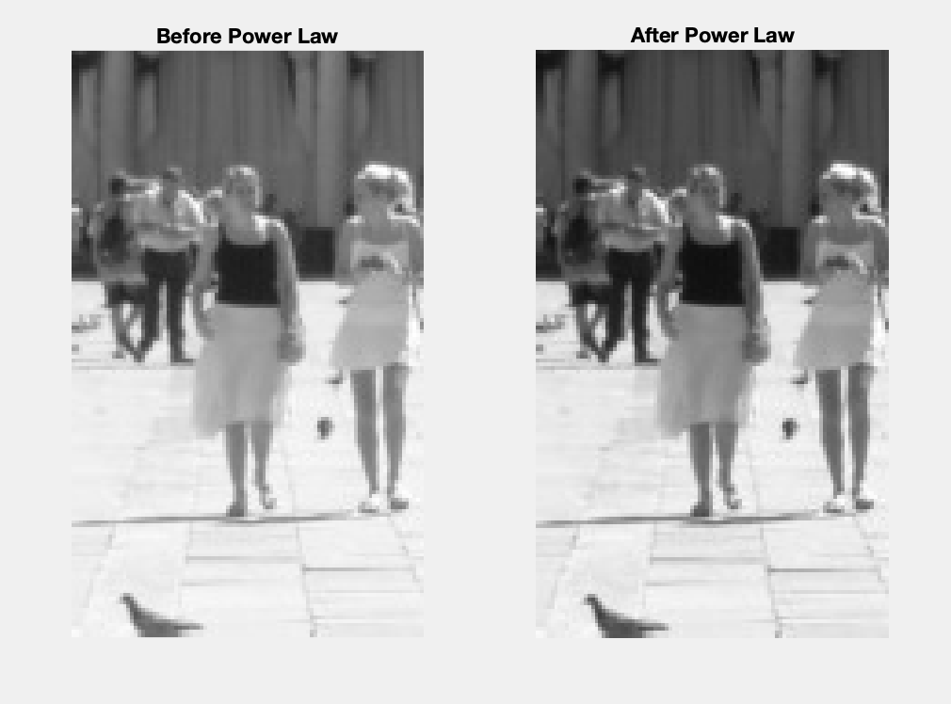
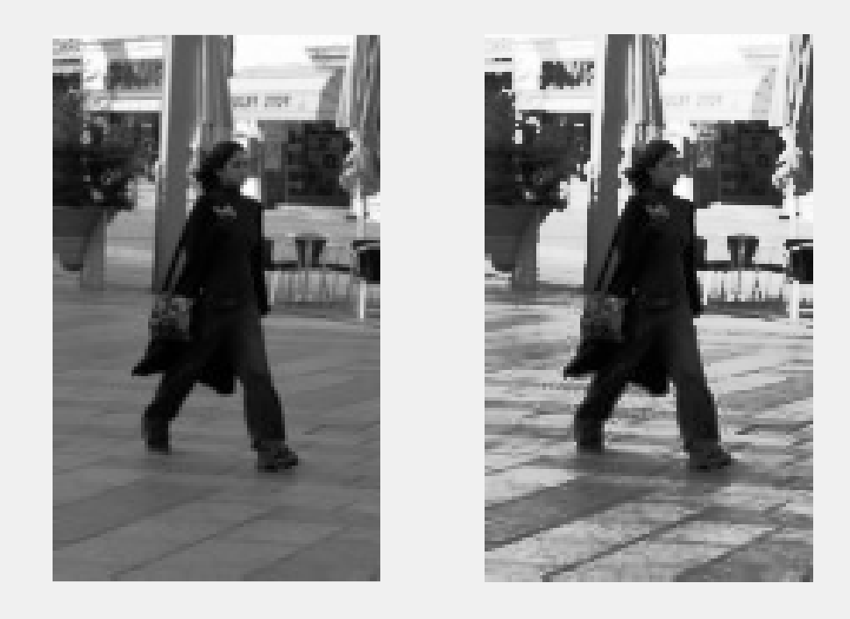
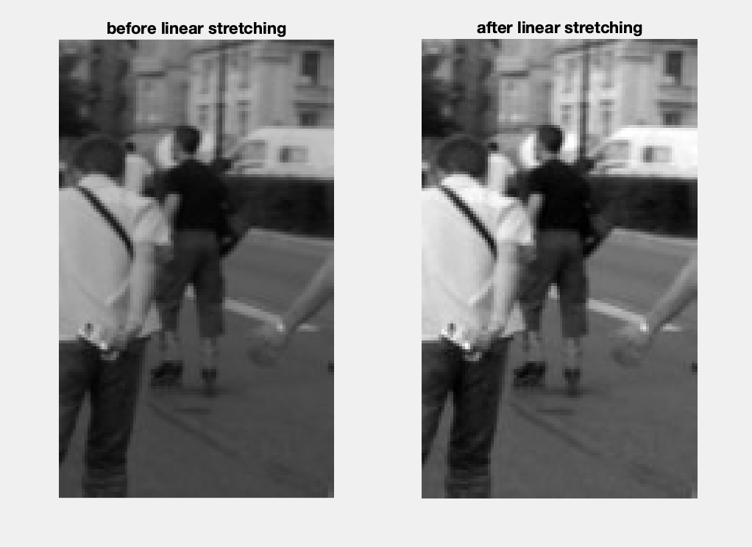
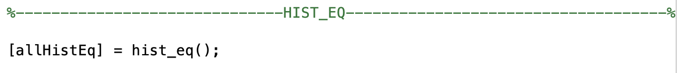
Pre-processing
Each technique has a function which generates a cell array for its output images. The functions are called in the “preprocessing driver” script to set up environment variables.
Power Law
Histogram equalization
Linear Stretching

Slide 3
Power law
Power law was effective in processing images that had a large spike in pixel values at either 0 or the max value. As you will see, like Histogram equalization, it had little effect on images that had an even spread of pixels throughout the range of values.

Slide 4
Histogram equalization
It was found that Histogram equalization works well when there are large numbers of pixels with the same value grouped together, however it was unsuccessful in extracting features in an image that that has an even spread of pixels throughout the range of values.

Slide 5
Linear stretch
It was found that the less spread out the pixel values, the greater effect linear stretch would have. Generally, the higher the gradient of the look up table, the more the image gets stretch and this the more the contract increases. From the sample taken, linear stretch always seems to maintain its detail without the loss of colour accuracy of part of the image becoming too dark or light.

Slide 6
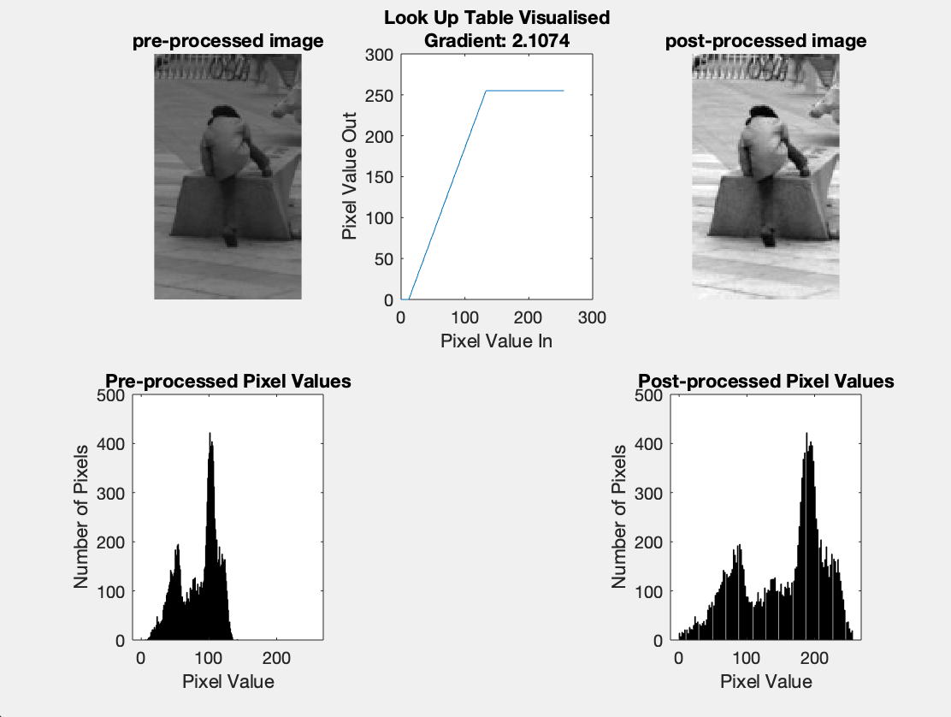
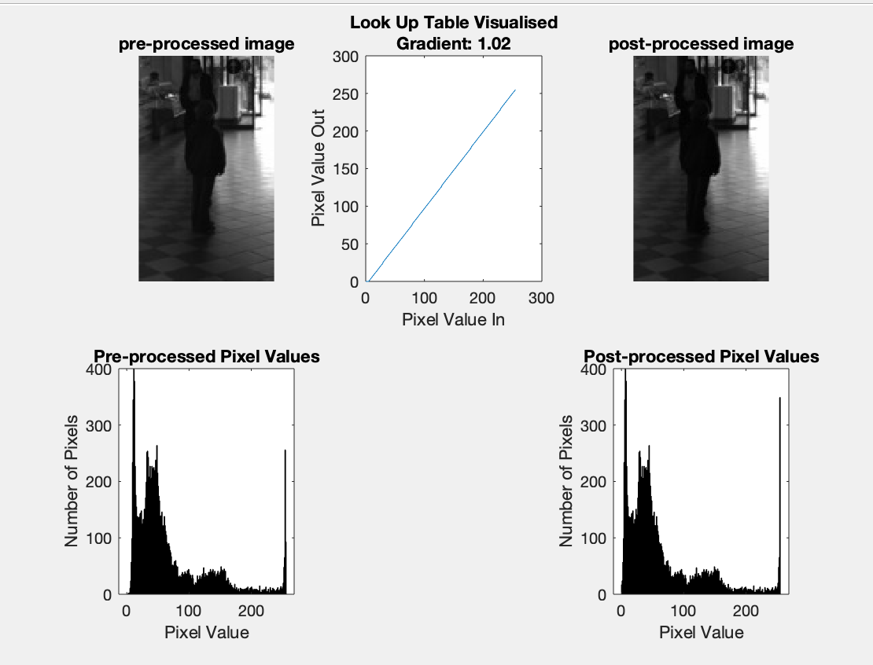
A threshold of 1.3 was estimated to be an acceptable gradient for linear stretching

Slide 7
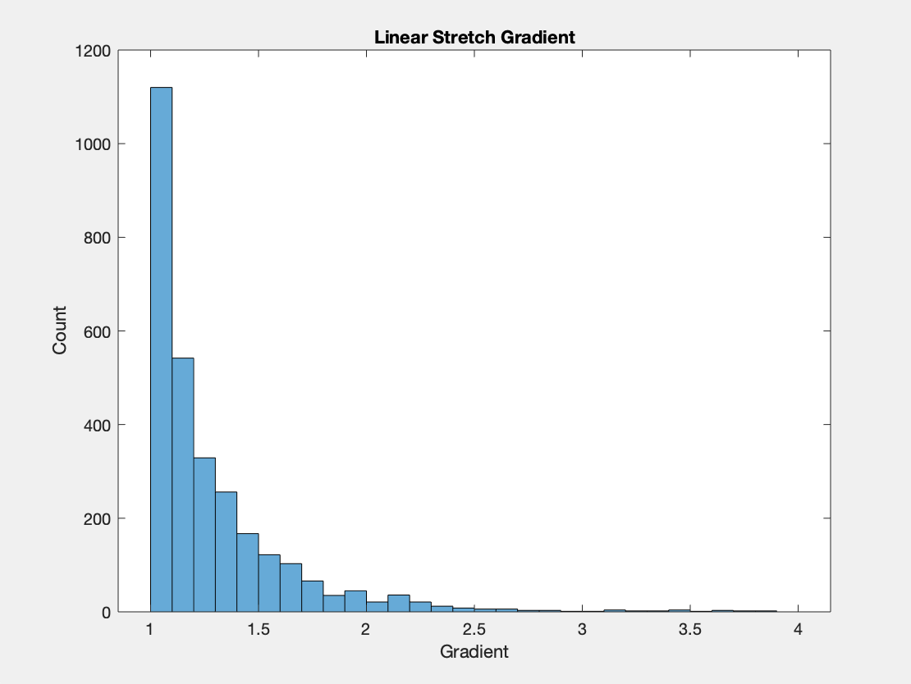
Fig 11.1 Histogram to show the range and frequencies of the linear stretch gradient over the entire dataset.
It was found that 68.1% of images have a gradient under 1.3. This would suggest that linear stretch will only be effective on 31.9% of images.
Without testing, it is impossible to know is this will negatively affect the results later on. Perhaps most of the images that have a linear stretch gradient below 1.3 are already sufficient for feature extraction.

Slide 8
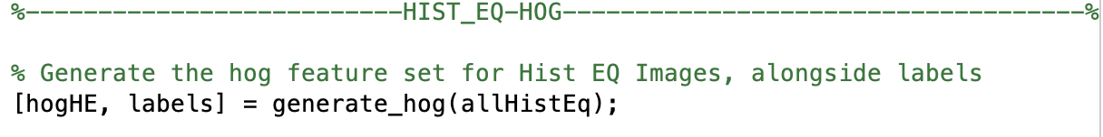
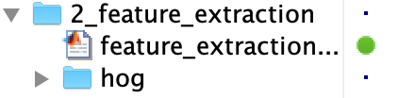
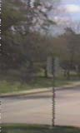
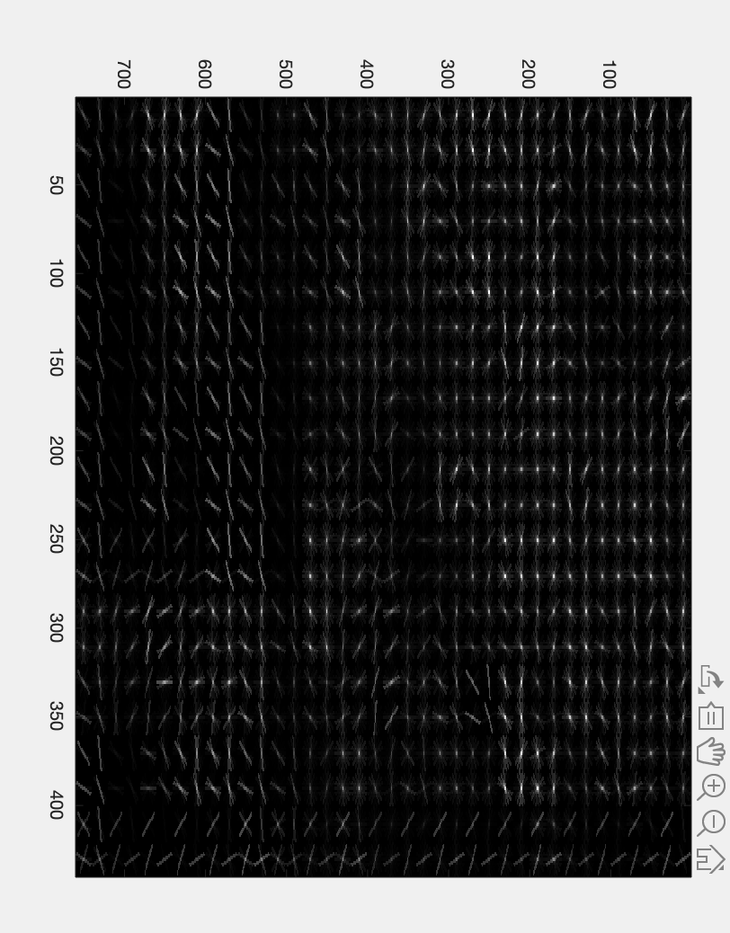
Feature Extraction
Similarly to preprocessing, feature extraction is organized such that each technique has its own folder containing respective functions. The environment variables for this section are also set up using a “feature extraction driver” script i.e.
HOG
Full image
Pros
Quicker processing speed
Cons
Harder to understand for human
Pros
Easier to visually see features
Cons
Longer to process

Slide 9
Feature Extraction
Only the HOG feature extraction was used. HOG of gradients was used on all three preprocessing techniques. And passed on to the machine learning algorithms.
If we have enough time, we are open to trying different feature extraction methods.

Slide 10
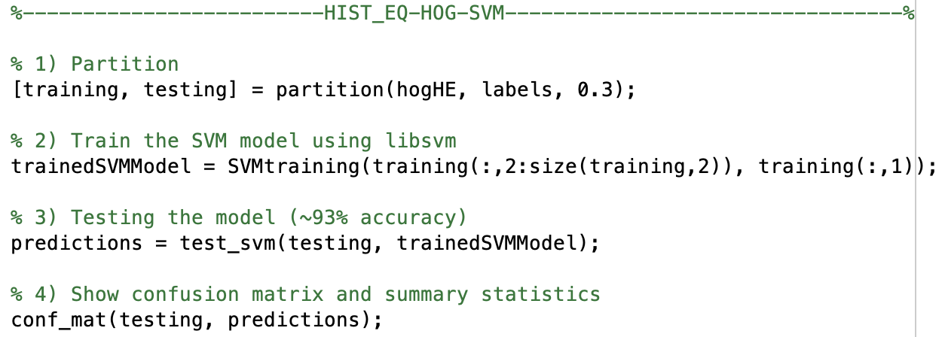

Training/Testing
There were 2 methods tested:
Hold Out
K-Fold Cross validation (values for accuracy are means of CV)

Slide 11
Training/Testing
Ultimately, 5-fold cross validation was selected to be used.
This ensured all the data could be used for testing and training purposes.

Slide 12
Training/Testing
Metrics Maintained Mean Raw Accuracy: The mean accuracy over all folds Individual Raw Accuracy: Useful for calculating intra variance, SD Time: Track the time taken for classification testing/training Confusion Matrix: Show numbers of TP, FP, TN, FN - misclassification Evaluation Metrics: FAR, F Measure, Specificity, Recall, Precision The purpose of gathering metrics is to allow for a detailed report whereby our decisions are supported by data and reasoning based on visualization.

Slide 13
SVM vs KNN – time taken to train and test
The time taken for each model to be trained is insignificant. SVM takes about 6 seconds to train on 2400 images while KNN takes less than 0.1 second to train on the same volume of images.

Slide 14
SVM vs KNN – Accuracy
To test both the accuracy of KNN and SVM as well as the preprocessing techniques, SVM and KNN were run using all three pre-processing techniques.
Highest SVM accuracy = 0.97 (with Histogram Equalization)
Highest KNN accuracy = 0.92 (with Linear Stretching)

Slide 15
Accuracy for Knn Classifier (Using HOG, 5-Fold CV)

Slide 16
Accuracy (SVM)

Slide 17
Other Evaluation metrics (SVM)

Slide 18
SVM vs KNN – Final decision
To get the best accuracy, SVM using power law was selected to be used.
While it is twice as slow as KNN, it produces significantly better results.

Slide 19
Images – Action PLAN
We have almost finished or analysis on the 3000 supplied images.
We plan to introduce Dimensionality Reduction to mitigate the fact that SVM is considerably slower than KNN

Slide 20
Video – Action plan – pre-processing
Background subtraction will not be effective since there are many people in the video and the background in moving.
To compensate for the fact that there is a moving background, optical flow Gaussian Mixture Model will be tested and the method that yields the best results will be selected.

Slide 21
Video – Action plan – post-processing
To select a correct threshold level, methods such as automatic thresholding, otsus method and the iterative global method will be used to create a binary video.

Slide 22
Video – Action plan – post-processing and detection
To select a correct threshold level, methods such as automatic thresholding, Otsu's method and the iterative global method will be used to create a binary video.
Using opening and/or closing methods, we will create blobs. These blobs should represent people.

